Slide 1



QUANTITATIVE APPROACH ON TOURISM DYNAMICS IN LIGHT OF CLIMATE CHANGE AND EXTREME WEATHER EVENTS
Nguyen Thanh Thanh Duong
Public Governance, Management and Policy
Department of Statistical Sciences “Paolo Fortunati”

Slide 2
Table of Content
Introduction
Measuring and forecasting the impacts of climate change and business cycle on tourism dynamics
Effects of extreme weather events on tourism dynamics: May 2023 floods in Emilia-Romagna and future probabilities
Conclusion

Slide 3
WHY?

Slide 4


Tourism is economic backbone: with >10% of GDP contribution and supports millions of jobs (UNWTO, 2019; WTTC, 2024, 2025) and Key source of public revenue through tourist taxes and related industries (Rotaris et al., 2019; Cellini & Torrisi, 2013)
Tourism industry and weather-sensitive: The Mediterranean is a climate change hotspot (IPCC, 2021) and Threats: Gradual climate shifts (reduced comfort) and extreme events (floods, fires) (Gössling & Hall, 2006; Capozzi et al., 2025)
Lack of studies integrating raw climate data into econometric models.
Few assessment combining economic losses with extreme events probabilities.
State-of-Art and the gaps to be filled

Slide 5


Bridging the gaps between economic and climate science by using the “raw” climate data in building an econometrics model to measure and forecast the impacts of climate change, extreme events and economic factors on tourism flows.
By quantifying the effects of climate dynamics and extreme events, this research provides data-driven evidence to inform targeted adaptation strategies, highlight the urgency of mitigation policies, and enhance the long-term resilience of the Italian tourism economy.
Contributions

Slide 6
1
2
3
Historical analysis: Tourism demand, climate variables & economic factors
Forecasting: Tourism dynamics under future climate scenarios (→2100)
Extreme events: 2023 Emilia-Romagna floods impact & future probability

Slide 7
CLIMATE CHANGE

Slide 8
Data – General and Economic
Time spanning: 1990 – 2023 for historical analysis; 2025 – 2100 for future forecasting
Variable unit: monthly
Spatially statistical unit: NUTS2 – 17 excluding Valle d’Aosta, Sicilia and Sardegna
Economic and tourist demand data (historical):
Domestic tourist ovenight stays (ISTAT)
GDP (ISTAT)
CPI (ISTAT)
Exchange rate (US Dollars to Euro)

Slide 9
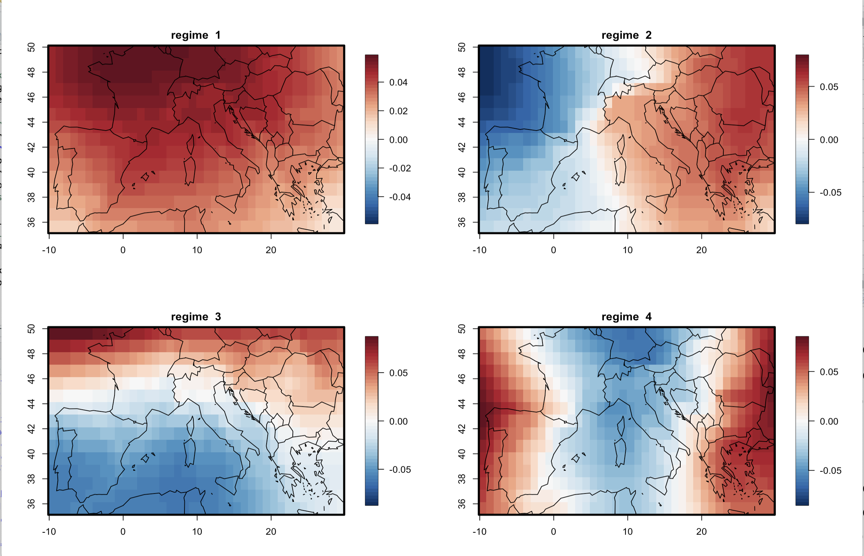
2-meter temperature
Solar radiation
Total precipitation
Extreme events
“Nice” variable
Weather regimes from sea level pressure
Data sources: ERA-5 (historical) and EURO-CORDEX (RCP 4.5 and 8.5)
Four weather regimes composed from daily sea level pressure
Data - Climate

Slide 10
Augumented Dickey-Fuller (ADF) Test to check the stationary of Domestic Overnight Stays and Economic variables
Data Aggregation and Interpolation for economic data preparation.
EOF (Empirical Orthogonal Functions) and data aggregation using CDO (Climate Data Operators) for climate data preparation.
OLS (Ordinary Least Squares) Stepwise Variable Selection for selecting climate variables.
Linear Regression for the final model estimation.
1
2
Applied bias correction using historical and ERA-5 reanalysis data.
Implemented fixed-coefficient models from the 1st study to forecast domestic overnight stays’ growth rates using the bias-corrected values of climate projections.
Calculated the projection values for summer (JJA); winter (DJF) and spring (MAM) in both RCP 4.5 and RCP 8.5.
Conducted ensemble analysis using median values from all 22 models

Slide 11



In the final models, there was no effects of extreme events on domestic overnight stays
Three models has been established for spring, summer, and winter
Regarding economic side, GDP has impacted most of the season, meanwhile exchange rate was significant for the overnight stays in summer and winter

Slide 12
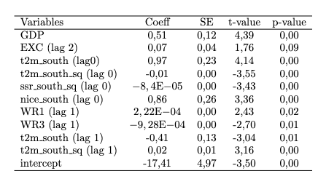
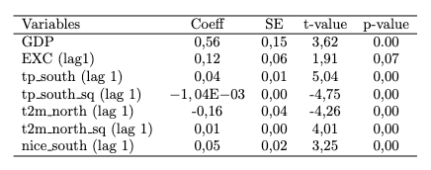
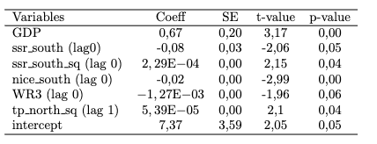
Climate matters: Temperature, precipitation, and solar radiation significantly affect domestic tourism, with seasonal and regional variation
Nonlinear effects: Extreme heat reduces summer demand; U-shaped effects in winter and spring
Lag structures: Booking decisions occur 1–2 seasons ahead (e.g., autumn climate influences winter travel)
Economic drivers: GDP consistently positive; exchange rate significant for summer and winter
Historical Analysis
Regression results of Summer, Winter and Spring

Slide 13
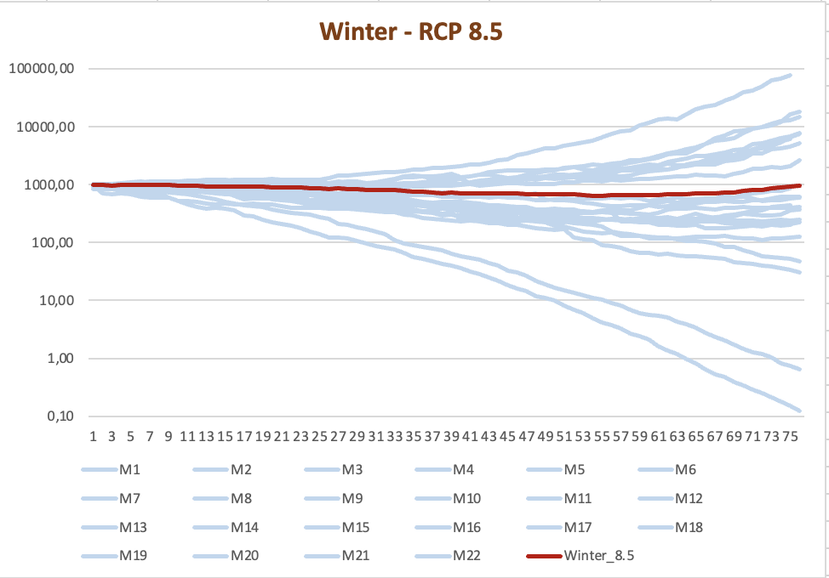
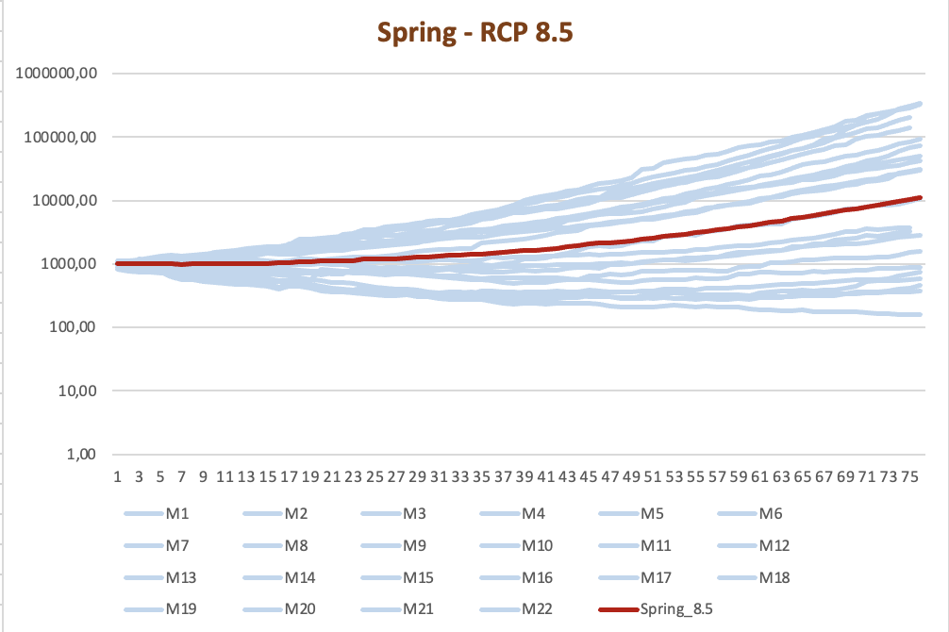
Winter (RCP 4.5): Warming reduces snow cover → fewer ski-related overnight stays
Winter (RCP 8.5): Declines to 2079, then rebounds as industry adapts (new products: city tours, seaside tourism in winter)
Spring (RCP 4.5): Warmer, summer-like conditions make spring more attractive
Spring (RCP 8.5): Higher warming → faster growth in spring demand
Forecasting
Stimulated values of domestic overnight stays (Winter and Spring) in Italy under RCP 8.5

Slide 14



Climate change is reshaping seasonal tourism in Italy
Tourism patterns are shifting over time
Climate change will further alter travel patterns, forcing the sector to adapt

Slide 15
EXTREME WEATHER EVENTS

Slide 16
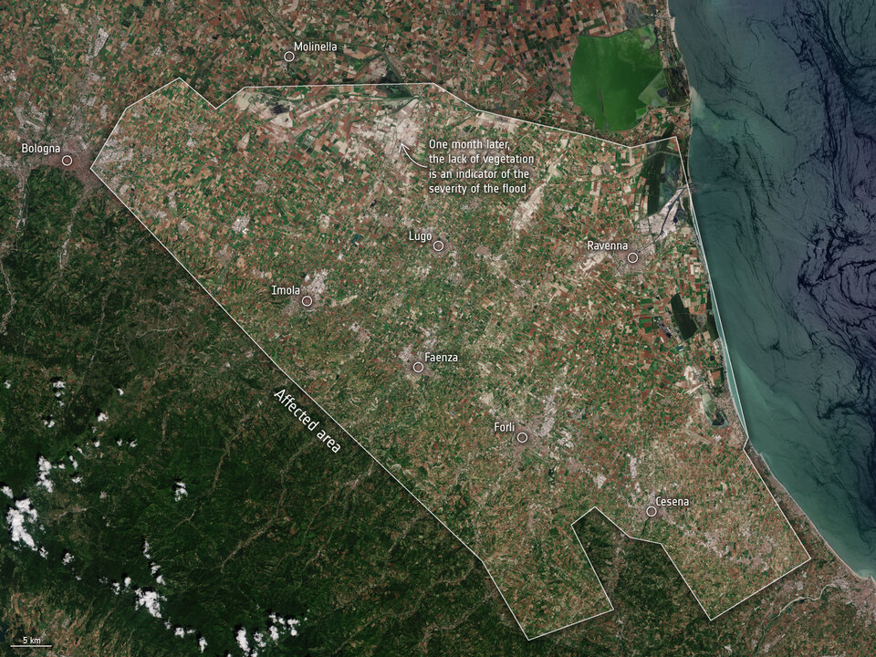
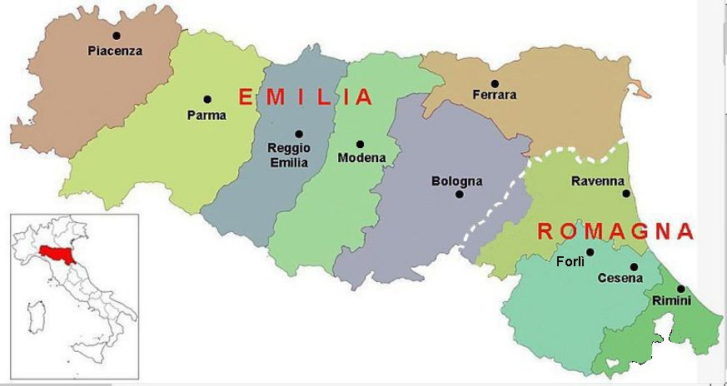
Region: Emilia-Romagna (Bologna, Piacenza, Parma, Ferrara, Modena, Reggio Emilia, Rimini, Forlì-Cesena, and Ravenna)
Location: Northeast Italy – one of the most affluent and developed regions in Italy and the EU (OECD, 2022)
May 2023 events: Two severe precipitation events; the second delivered ~350 million m³ of rain in 36 hours – equivalent to six months of normal rainfall – the largest on record for the first 21 days of May
Consequences: Widespread floods, nearly 400 landslides, 17 deaths, 36,000 people displaced, 700+ roads blocked, and estimated economic losses of €8–10 billion – severely impacting tourism
Case study
Map of affected areas in Emilia-Romagna region (ESA, 2023)
Map of sub-regions: Emilia and Romagna (Mezzacqui, 2021)

Slide 17
Tourist arrivals
Source: RER Statistica (Emilia-Romagna Region)
Period: Jan 2018 – Dec 2024 (daily)
Variable: Domestic arrivals (>80% of total tourism)
Selected provinces: Rimini, Forlì-Cesena, Ravenna
Hotel prices
Source: Booking.com (900+ hotels, 3–5-star)
Period: Apr 2023 – Feb 2025
Variable: Average daily prices (May 2023 focus)
Key Strength: Novel dataset – not used in prior research
Tourism Data

Slide 18
May 2023 Floods
ERA5 Reanalysis
Source: ECMWF / Copernicus
Period: 1950–2024
Resolution: 0.25° × 0.25°
Variable: Daily total precipitation
EURO-CORDEX Projections
Source: 63 GCM-RCM combinations from ESGF
Scenario: RCP 8.5 (high emissions)
Variable: Precipitation flux
Period: 1950–2100 (historical simulations and future projections)
Resolution: Re-gridded to 0.25° × 0.25°
Global Warming Levels: 0.61°C | 1.0°C | 1.5°C | 2.0°C | 3.0°C | 4.0°C
Future Probabilities
Climate Data

Slide 19
Tourist and accommodation losses’ estimation:
Step 1: Estimate Expected Arrivals (Counterfactual)
Align data from 2018, 2019, 2022, 2024 to May 2023 weekly calendar and apply piecewise linear interpolation to fill missing years (2020, 2021, 2023)
Loss in arrivals = Expected arrivals – Actual arrivals
Step 2: Estimate Expected Hotel Revenue
Expected revenue = Expected arrivals × Average daily price
Actual revenue = Actual arrivals × Average daily price
Loss in revenue = Expected revenue – Actual revenue
Extreme Precipitation Probability:
Durations: 1, 3, 7, 28 days (capture single events & compound events like May 2023)
Season: April–June (flood season)
Method: Generalized Extreme Value (GEV) distribution fitted to block maxima
Bias Correction: Threshold = same quantile as 2023 event (not absolute value)
Outcome: Exceedance probabilities & probability ratios by global warming level
Analysis: Linear Mixed Model (LMM) to test significance of warming effect
Methodology

Slide 20
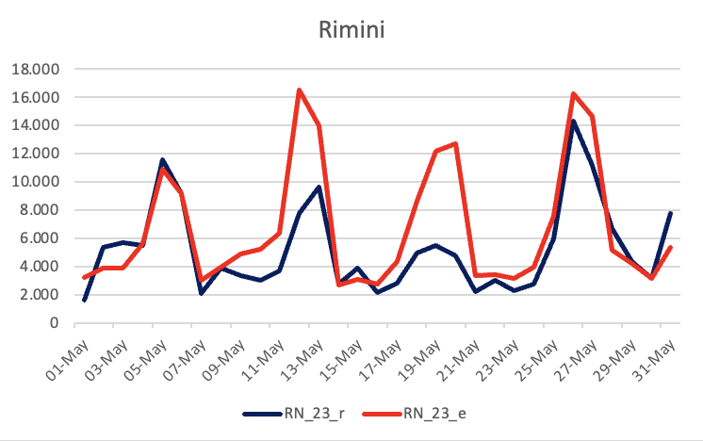
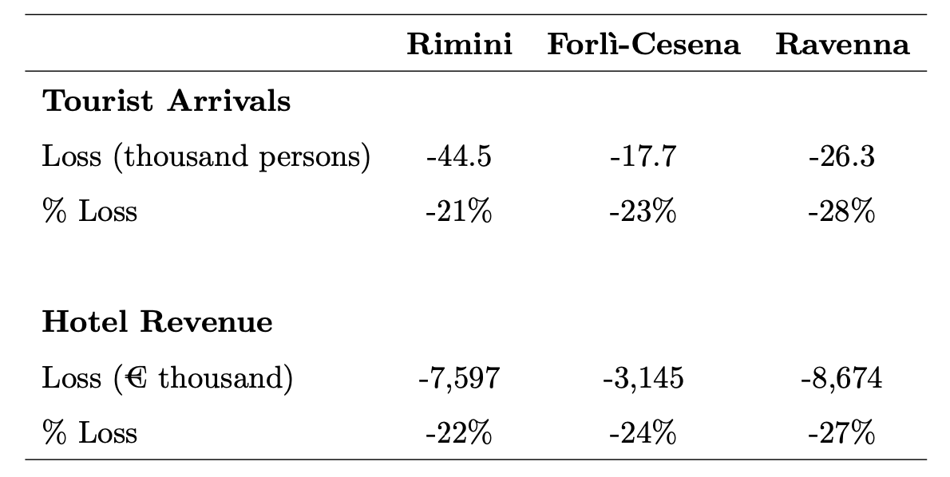
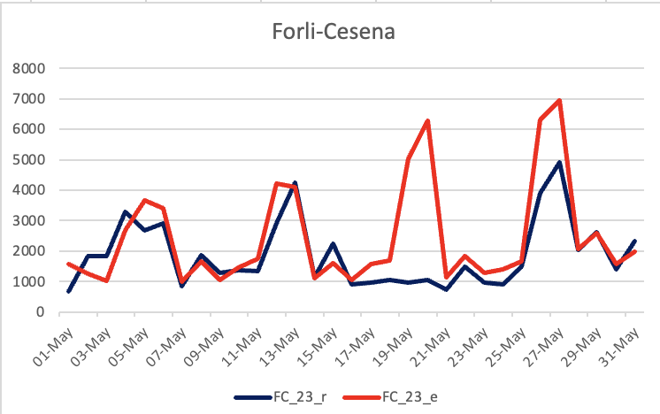
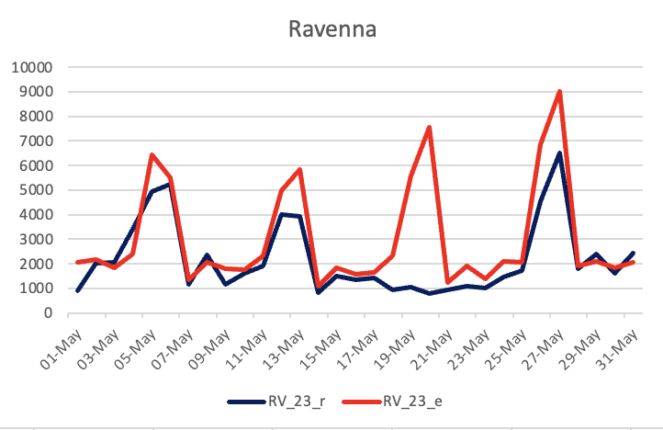
The observed and expected tourist arrivals in Rimini, Forlì-Cesena, and Ravenna in May 2023. The y-axis indicates the number of arrivals, and the x-axis shows the dates from May 1 to 31.
Estimated Losses in Tourist Arrivals and Hotel Revenue for May 2023
Results – Estimated Losses

Slide 21
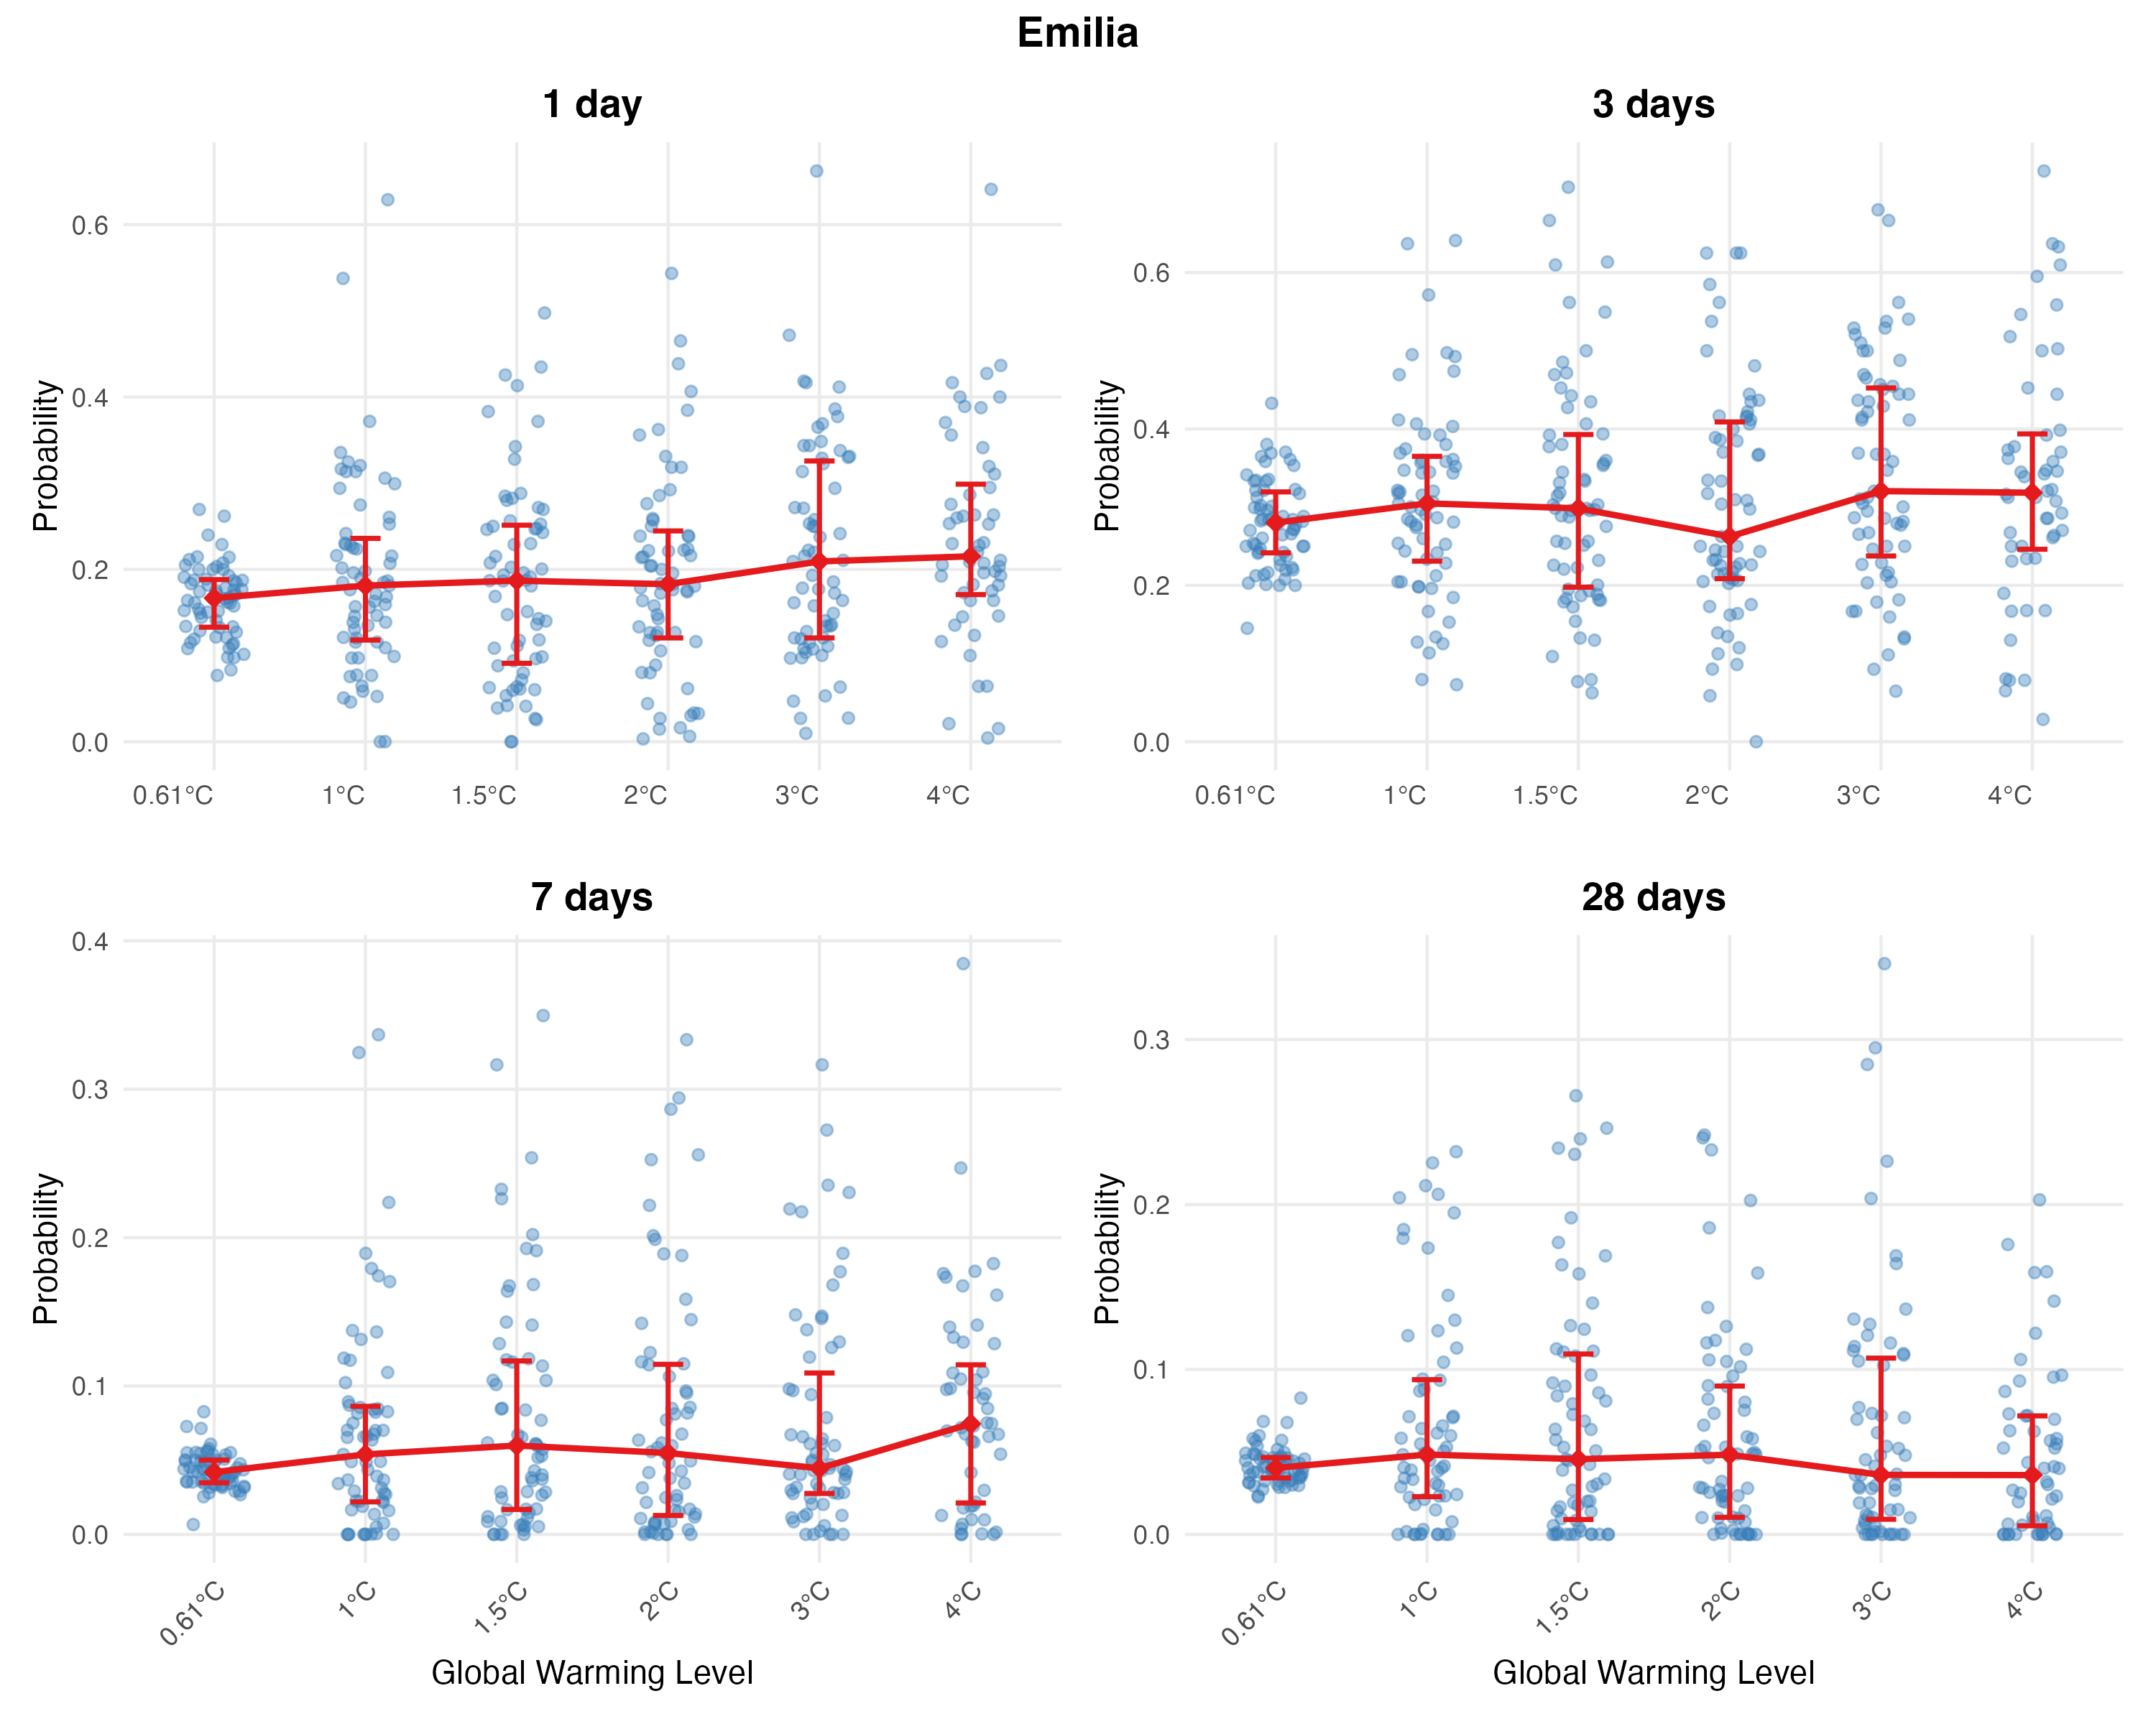
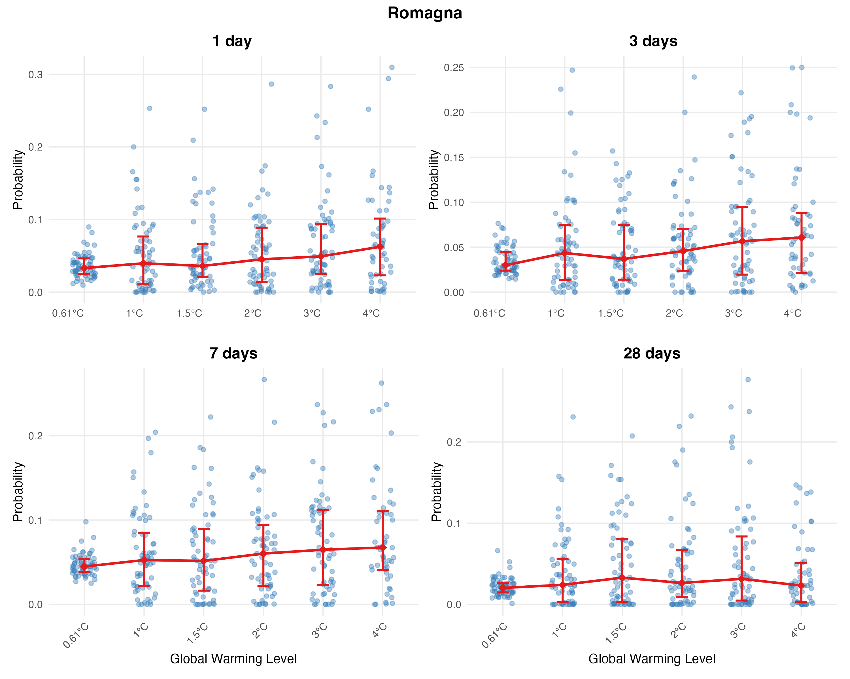
Results – Probabilities and Ratios
Statistical Significance of Probability Ratios
Most ratios not statistically significant (confidence intervals include 1)
Exceptions:
Emilia: 3-day & 7-day at 3°C
Romagna: 1-day & 3-day at 2°C
GEV-estimated flood probabilities for different GCM-RCM combinations (blue dots) across different global warming levels and flooding durations. Red indicators summarize the 25th and 75th percentiles, while a red diamond marks the median.

Slide 22
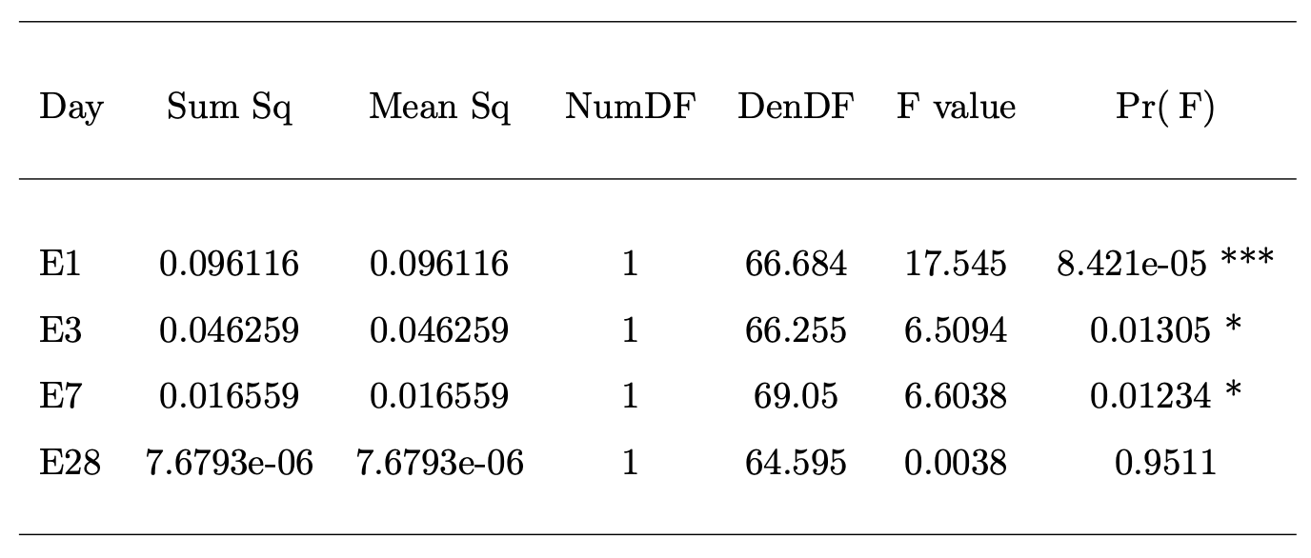
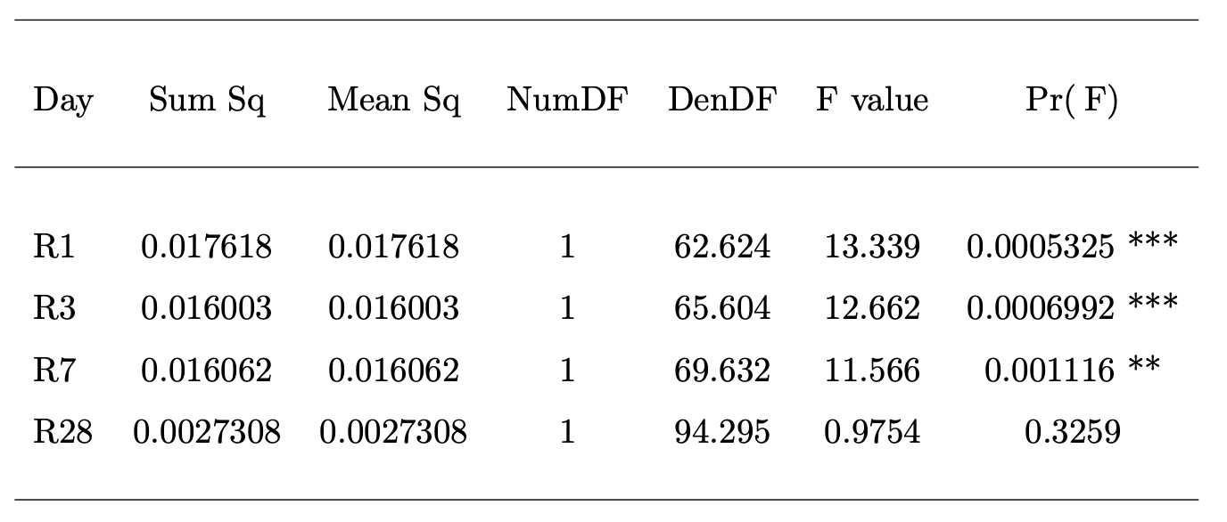
Key findings
Risk of short, extreme precipitation events increases with global warming levels
Consistent with Mediterranean climate projections: fewer but more intense precipitation events
28-day events do not show statistically significant
ANOVA Results for Emilia (E) and Romagna (R) with Satterthwaite's Method
Results - LMM

Slide 23
Scientific Contributions
Limitations
Scientific evidences on the impacts of climate change and extreme weather events (flood) on tourism dynamics.
First study engaging directly “raw” climate data from re-analysis and future projections to tourism econometrics models.
Limitations on data: spatiality (climate), time span and availability (economic).
Conclusion

Slide 24
Public Policymakers
Diversify products & business models: Evolve beyond sun-and-sea (summer) and snow-based (winter) offerings; capture growing spring demand; invest in non-snow winter products (cultural, wellness)
Adopt data-driven operations: Integrate weather data into dynamic pricing models to protect revenue during extreme events; use climate projections to inform investment and marketing strategies
Invest in resilience & continuity: Build business continuity plans for flood-prone areas; diversify geographically or seasonally to reduce exposure to single-region extremes; continuously innovate product portfolios as climate shifts seasonal attractiveness
Integrate climate projections into planning: Use historical sensitivities and future scenarios to identify long-term risks and opportunities; incorporate flood risk into infrastructure investments
Promote year-round tourism & targeted support: Reduce summer overcrowding by fostering spring and diversified winter offerings; provide proportionally greater disaster recovery support to more vulnerable provinces
Establish financial mechanisms: Create reserve funds ("rainy-day funds") for post-disaster recovery; use fiscal incentives (tax credits) for climate adaptation investments (energy efficiency, infrastructure resilience)
Private Businesses

Slide 25


SDG 13 – Climate Action
Enhances quantitative understanding of climate change impacts on tourism economy (national to regional levels)
Translates climate projections into sector-specific risks, providing scientific evidence base for adaptation and mitigation policies
SDG 8 – Decent Work and Economic Growth
Reveals projected shifts in tourism business cycle under future climate scenarios
Identifies sub-regional vulnerabilities (e.g., Ravenna, Forlì-Cesena) to inform sustainable economic growth strategies
Leverages seasonal demand redistribution to foster stable tourism development and address seasonal employment challenges
Enabling Mechanisms
Public governance: Implement financial safety nets (e.g., reserve funds) for vulnerable sub-regions
Private sector: Adopt dynamic pricing strategies to protect revenue and build resilience
Contributions to SDGs

Slide 26
THANK YOU

